Slide 1
Nutrition: the Mind-Gut Connection
J.J.J. Postma, DC, DACNB
T. D. M. Claykens, DC, DACNB
R. Koldewijn-Erdbrink, registered dietician

Slide 2
Covered topics
Nutrition: the Mind-Gut connection
- Cell metabolism and neuron theory
- the role of stress and cortisol production
- Brain and it’s influence on the gut
- Importance of vagal tone
- Gut and it’s influence on brain
- Anti-inflammatory foods
- Reineke Koldewijn-Erdbrink- Simply the Right Food
- How to repair a leaky gut

Slide 3
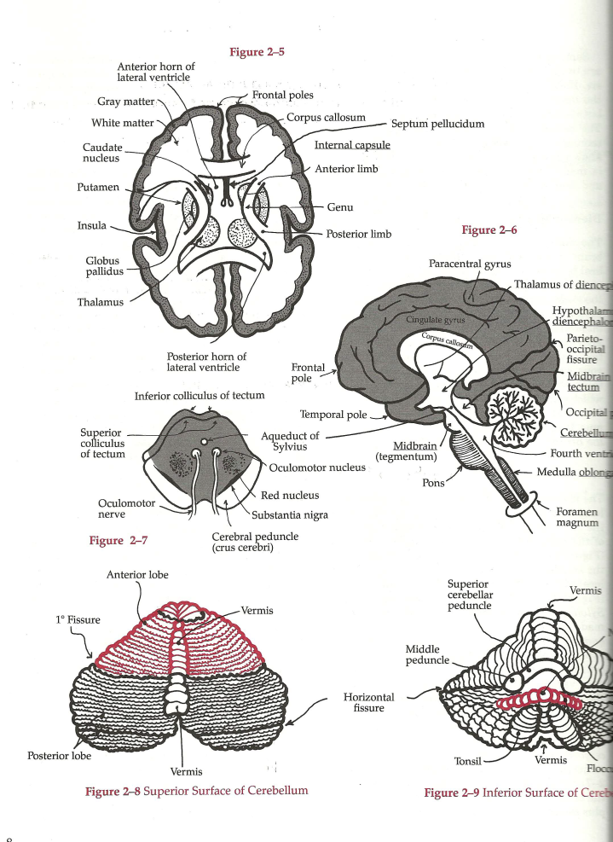
Cell metabolism
Glucose
Oxygen
CIEG (Cellular immediate early genes)
Protein replication
Mitochondria
ATP
Maintains transmembrane
Potential gradient
Maintains Na+ pumps

Slide 4
Promotors of neural degeneration
Lack of stimulation
Inflammatory responses
Microglia activation
Dysglycemia (abnormal blood sugar levels)
Methylation imbalances
Deficiency of nutrients
Hormone imbalances

Slide 5
Changes in neuronal transmembrane potential gradient
Removal of magnesium block on NMDA receptors which causes influx of calcium into the cytosol
This results in
Increased mitochondrial free radical production
Nitric oxide production which leads to DNA and mitochondrial damage and further breakdown of the cell
Notes:
Inervates cranial motor nuclei bilaterally with the exception of the lower motor nuclei of the VII and XI which are innervated only unilaterally by the contralateral cortex. The corticobulbar tract innvervates directly the cranial nerves V, VII, XI and XII, and contributes to the motor regions of the IX and X (nucleus ambiguus) cranial nerves. It does not innervate the III, IV and VI (MLF)

Slide 6
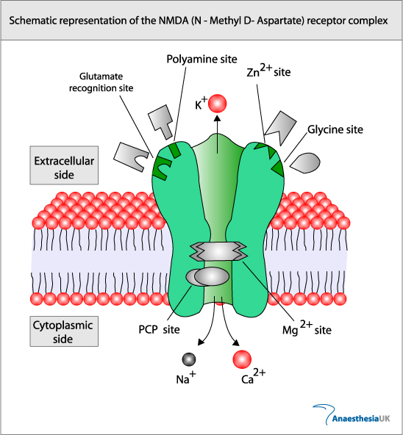
NMDA receptor complex
Notes:
Inervates cranial motor nuclei bilaterally with the exception of the lower motor nuclei of the VII and XI which are innervated only unilaterally by the contralateral cortex. The corticobulbar tract innvervates directly the cranial nerves V, VII, XI and XII, and contributes to the motor regions of the IX and X (nucleus ambiguus) cranial nerves. It does not innervate the III, IV and VI (MLF)

Slide 7
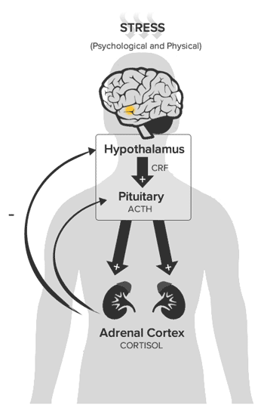
HPA-axis ww.youtube.com/watch?v=BIfK0L8xDP0
Notes:
Inervates cranial motor nuclei bilaterally with the exception of the lower motor nuclei of the VII and XI which are innervated only unilaterally by the contralateral cortex. The corticobulbar tract innvervates directly the cranial nerves V, VII, XI and XII, and contributes to the motor regions of the IX and X (nucleus ambiguus) cranial nerves. It does not innervate the III, IV and VI (MLF)

Slide 8
Increased mesencephalic activation
Neurological
HPA-axis
Increased IML activity
Adrenal medulla released plasma catecholamines- epinephrine, norepinephrine, dopamine
Depolarization of C-fibers
Release of neuropeptide substance P leading to tissue inflammation
Effect of decreased cortical inhibition via PMRF
Most often due to physical or emotional STRESS
Notes:
Inervates cranial motor nuclei bilaterally with the exception of the lower motor nuclei of the VII and XI which are innervated only unilaterally by the contralateral cortex. The corticobulbar tract innvervates directly the cranial nerves V, VII, XI and XII, and contributes to the motor regions of the IX and X (nucleus ambiguus) cranial nerves. It does not innervate the III, IV and VI (MLF)

Slide 9
Adrenal cortisol release is modulated by:
Hypothalamus-pituitary- adrenal axis (HPA)
Quantity of the release
Hippocampus modulation of cortisol
Coordination of the circadian rhythm
Pineal modulation of melatonin
Coordination of the circadian release
Mesencepthalic modulation of autonomics
Amplitude of cortisol response
Notes:
Inervates cranial motor nuclei bilaterally with the exception of the lower motor nuclei of the VII and XI which are innervated only unilaterally by the contralateral cortex. The corticobulbar tract innvervates directly the cranial nerves V, VII, XI and XII, and contributes to the motor regions of the IX and X (nucleus ambiguus) cranial nerves. It does not innervate the III, IV and VI (MLF)

Slide 10
Cortisol- the stress hormone
Released in response to stress- increased sympathetic stimulation
Allows the body to work 110 %
Useful in acute situations of need
Harmful if continually elevated levels due to stress of modern day living, resulting in:
Poor sleep
Increased blood pressure
Brain effects
Loss of memory
Lack of concentration
Depression
Depressed immune system
Fatigue
Loss of lean muscle mass
Weight gain
Cardiovascular effects
Increased blood sugar
Intestinal complaints
Aging
Notes:
Inervates cranial motor nuclei bilaterally with the exception of the lower motor nuclei of the VII and XI which are innervated only unilaterally by the contralateral cortex. The corticobulbar tract innvervates directly the cranial nerves V, VII, XI and XII, and contributes to the motor regions of the IX and X (nucleus ambiguus) cranial nerves. It does not innervate the III, IV and VI (MLF)

Slide 11
Cortisol and melatonin rhythm

Slide 12
Supplements to balance circadian rhythm
Pannax ghinseng
Siberian ghinseng
Ashwagandha
Holibasal leaf extract
Rhodiola
Boerhaave Diffusa
Panathine
Vitamine C
Notes:
Inervates cranial motor nuclei bilaterally with the exception of the lower motor nuclei of the VII and XI which are innervated only unilaterally by the contralateral cortex. The corticobulbar tract innvervates directly the cranial nerves V, VII, XI and XII, and contributes to the motor regions of the IX and X (nucleus ambiguus) cranial nerves. It does not innervate the III, IV and VI (MLF)

Slide 13
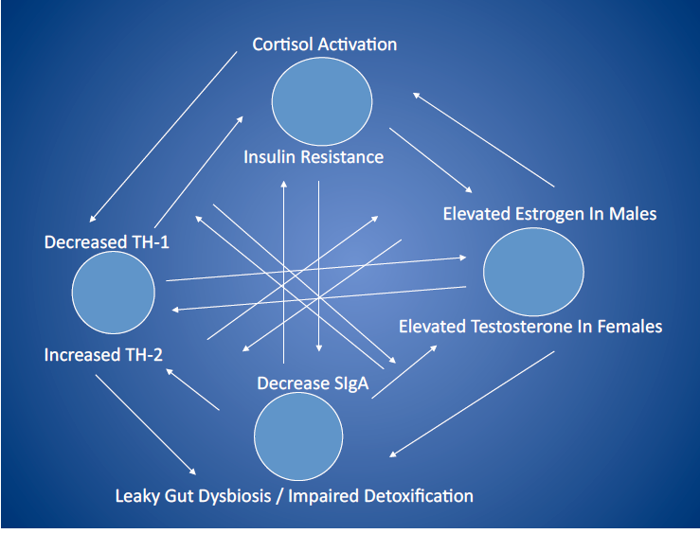
Cortisol levels can lead to insulin resistance

Slide 14
Tips to lower cortisol levels
Sports and movement
Laugh, enjoy life, look on the bright side
Music
Relaxation exercises, techniques
Social activities
http://youtu.be/nW0fM4CBEhk
Notes:
Inervates cranial motor nuclei bilaterally with the exception of the lower motor nuclei of the VII and XI which are innervated only unilaterally by the contralateral cortex. The corticobulbar tract innvervates directly the cranial nerves V, VII, XI and XII, and contributes to the motor regions of the IX and X (nucleus ambiguus) cranial nerves. It does not innervate the III, IV and VI (MLF)

Slide 15
Brain-Gut axis
Stress
Frontal cortex, insular cortex, vagal motor nuclei, hypothalamus
Neural projections from hypothalamic hormones
Gut
Enteric nervous system
Intestinal Immune system
Intestinal microglia
Production of cytokines, gut opioids, gut peptides
Notes:
Inervates cranial motor nuclei bilaterally with the exception of the lower motor nuclei of the VII and XI which are innervated only unilaterally by the contralateral cortex. The corticobulbar tract innvervates directly the cranial nerves V, VII, XI and XII, and contributes to the motor regions of the IX and X (nucleus ambiguus) cranial nerves. It does not innervate the III, IV and VI (MLF)

Slide 16
Components of the Autonomic Nervous System
Sympathetic nervous system- ‘fight and flight’
Parasympathetic nervous system- ‘rest and digest’
Stimulate and control structures not under conscious control
Both systems are tonically active to help maintain a stable internal environment in face of changing conditions
Enteric nervous system- embedded in the lining of the gastrointestinal system
Notes:
Inervates cranial motor nuclei bilaterally with the exception of the lower motor nuclei of the VII and XI which are innervated only unilaterally by the contralateral cortex. The corticobulbar tract innvervates directly the cranial nerves V, VII, XI and XII, and contributes to the motor regions of the IX and X (nucleus ambiguus) cranial nerves. It does not innervate the III, IV and VI (MLF)

Slide 17
Enteric Nervous System
Generates intestinal motility
Generates enzyme release
Provides afferent input to the vagus
More neurons then the entire spinal cord
Can operate independent of CNS- peristalsis
Notes:
Inervates cranial motor nuclei bilaterally with the exception of the lower motor nuclei of the VII and XI which are innervated only unilaterally by the contralateral cortex. The corticobulbar tract innvervates directly the cranial nerves V, VII, XI and XII, and contributes to the motor regions of the IX and X (nucleus ambiguus) cranial nerves. It does not innervate the III, IV and VI (MLF)

Slide 18
Intestinal bacteria (microbiome)
Firmicutes
Bacteroidetes
F/B ratio important
Represent 90 % of bacterial population in the colon
90% of serotonin is manufactured in the gut!
Regulation of immune cells/hormones
Notes:
Inervates cranial motor nuclei bilaterally with the exception of the lower motor nuclei of the VII and XI which are innervated only unilaterally by the contralateral cortex. The corticobulbar tract innvervates directly the cranial nerves V, VII, XI and XII, and contributes to the motor regions of the IX and X (nucleus ambiguus) cranial nerves. It does not innervate the III, IV and VI (MLF)

Slide 19
If born by C-section:
5X more risk for allergies
3X more risk ADHD
2X more risk autism
80% risk celiac disease
50% risk of becoming obese
70% risk of type I diabetes
Notes:
Inervates cranial motor nuclei bilaterally with the exception of the lower motor nuclei of the VII and XI which are innervated only unilaterally by the contralateral cortex. The corticobulbar tract innvervates directly the cranial nerves V, VII, XI and XII, and contributes to the motor regions of the IX and X (nucleus ambiguus) cranial nerves. It does not innervate the III, IV and VI (MLF)

Slide 20
Decreased activity of brain
Decreased projection and stimulation of vagal nuclei and PMRF
Decreased intestinal blood flow and suppressed intestinal immune activation
Leads to
Decreased intestinal motility
Intestinal yeast and bacteria overgrowth
Intestinal permeability and inflammation
Notes:
Inervates cranial motor nuclei bilaterally with the exception of the lower motor nuclei of the VII and XI which are innervated only unilaterally by the contralateral cortex. The corticobulbar tract innvervates directly the cranial nerves V, VII, XI and XII, and contributes to the motor regions of the IX and X (nucleus ambiguus) cranial nerves. It does not innervate the III, IV and VI (MLF)

Slide 21
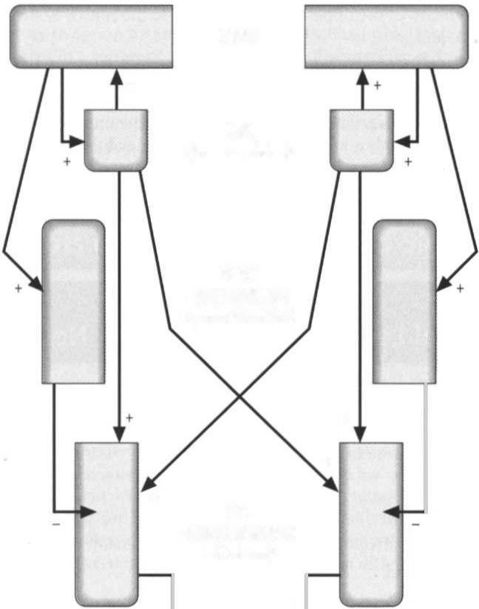
Hemisphericity concept
How do we assess for cerebral asymmetry
Via the analysis of the autonomic nervous system.
So when IML is high you can expect:
Large pupils, fatiguable on light response
Increased vein-to-artery ratio
Increased sweating & decreased skin temperature (cold and clamy hands)
Arrhythmia (high left IML)
Tachycardia (high right IML)
Dry mounth
Fast and shallow breathing
Increased muscle tone in the anterior muscle groups above T6
Increased muscle tone in the posterior muscle groups below T6
Cortex
MES
PMRF
IML
PNS

Slide 22
Vagus nerve (CN X)
Most important cranial nerve because most fibers are parasympathetic neurons that innervate heart, lungs, and all abdominal viscera up to the left colic flexure (proximal 2/3 colon)
Dorsal motor nucleus of the vagus to ganglia of organs innervated
Notes:
Inervates cranial motor nuclei bilaterally with the exception of the lower motor nuclei of the VII and XI which are innervated only unilaterally by the contralateral cortex. The corticobulbar tract innvervates directly the cranial nerves V, VII, XI and XII, and contributes to the motor regions of the IX and X (nucleus ambiguus) cranial nerves. It does not innervate the III, IV and VI (MLF)

Slide 23
Vagal nuclei (CN X)
Activates intestinal motor cells for gut motility
Modulates intestinal blood flow
Activates release of intestinal enzymes
Malabsorption
Excites the vagal nuclei to activate gut motility and enzyme secretion
Notes:
Inervates cranial motor nuclei bilaterally with the exception of the lower motor nuclei of the VII and XI which are innervated only unilaterally by the contralateral cortex. The corticobulbar tract innvervates directly the cranial nerves V, VII, XI and XII, and contributes to the motor regions of the IX and X (nucleus ambiguus) cranial nerves. It does not innervate the III, IV and VI (MLF)

Slide 24
How to stimulate the Vagus Nerve (CNX)
Speech, phonation, saying “Ah”, gargling, singing.
Daily cold showers.
Rectal dilatation increases vagal feedback.
Laughter, positive thinking.
Intermittent fasting.
tVNS

Slide 25
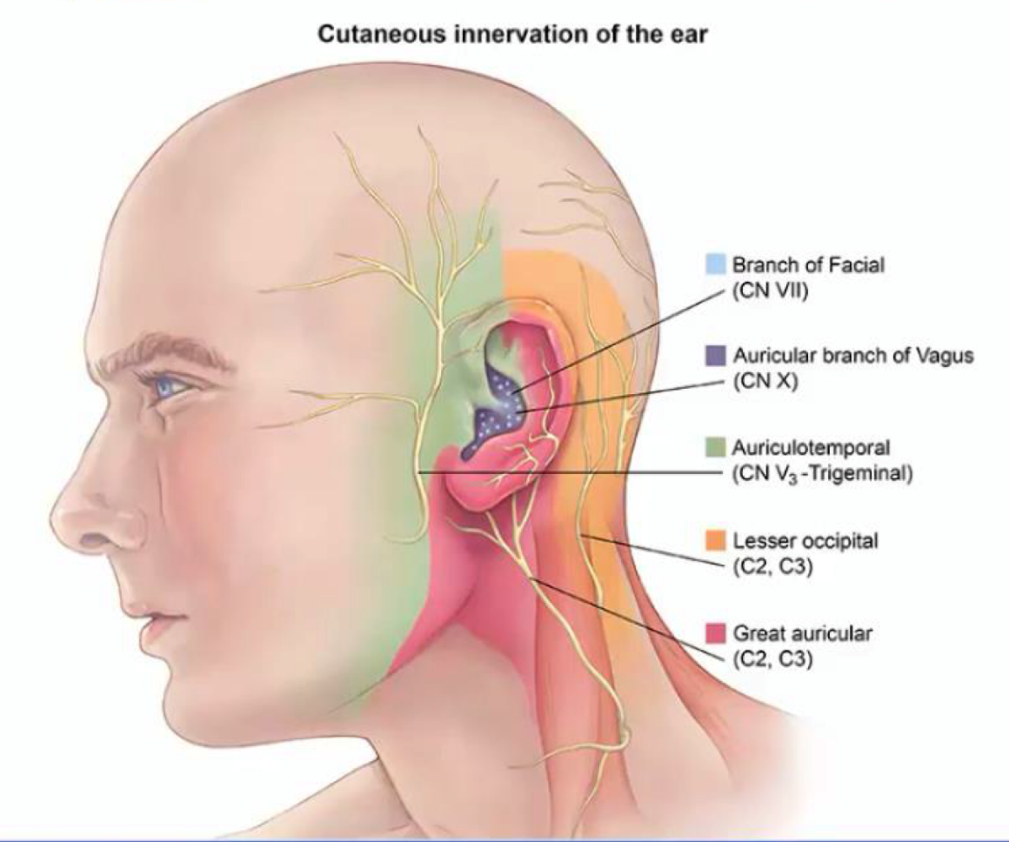
tVNS (Transcutaneous Vagal Nerve Stimulation)

Slide 26
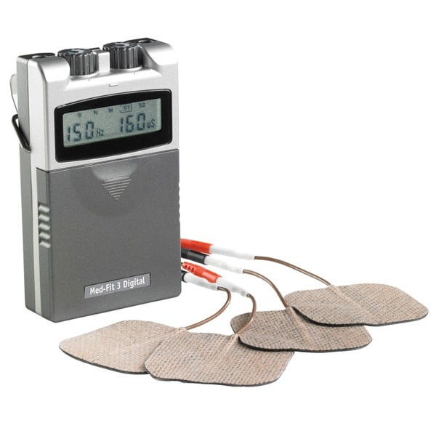
tVNS (Transcutaneous Vagal Nerve Stimulation)
Suggested Frequencies and duration:
30Hz - 200µS
Duration depends on subject.

Slide 27
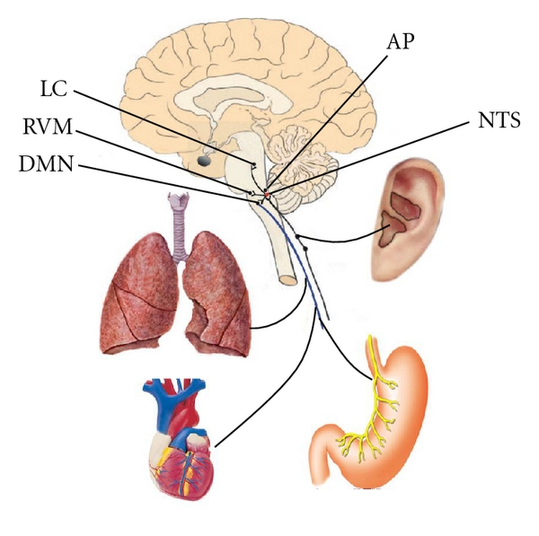
tVNS (Transcutaneous Vagal Nerve Stimulation)
“Auriculovagal afferent pathway” (AVAP): both the autonomic and the central nervous system could be modified by auricular vagal stimulation via projections from the ABVN at the auricular concha to the NTS (see Figure 3). NTS: nucleus of the solitary tract; DMN: dorsal motor nucleus of the vagus; AP: area postrema; RVM: rostral ventrolateral medulla; LC: locus coeruleus.

Slide 28
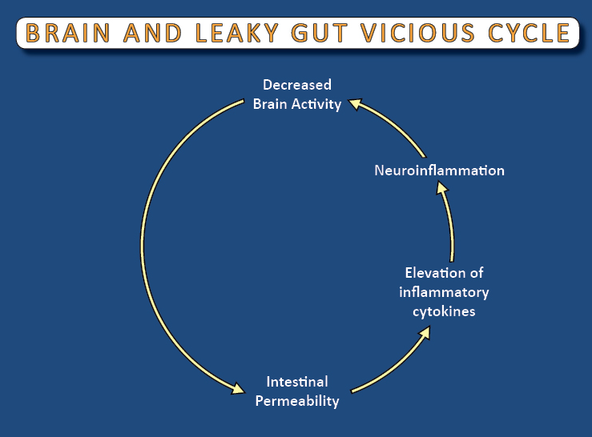
Brain and leaky gut

Slide 29
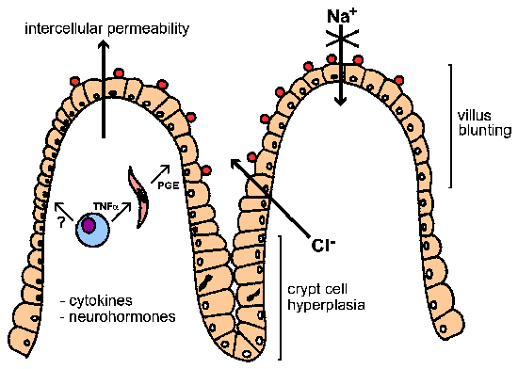
Intercellular permeability

Slide 30
Brain and leaky gut

Slide 31
Intestinal inflammation
Production of inflammatory cytokines
Cross Blood Brain barrier and activate brain microglia
Brain inflammatory neurodegeneration
Enteric nervous system inflammatory neurodegeneration
Utimately lead to Gut Brain axis neurodegeneration
Notes:
Inervates cranial motor nuclei bilaterally with the exception of the lower motor nuclei of the VII and XI which are innervated only unilaterally by the contralateral cortex. The corticobulbar tract innvervates directly the cranial nerves V, VII, XI and XII, and contributes to the motor regions of the IX and X (nucleus ambiguus) cranial nerves. It does not innervate the III, IV and VI (MLF)

Slide 32
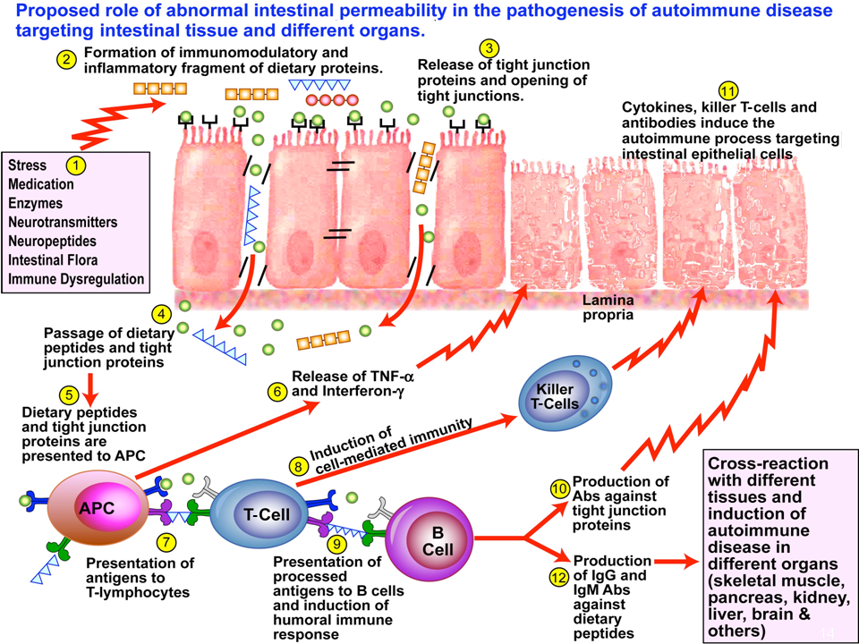
Intestinal inflammation
Notes:
Inervates cranial motor nuclei bilaterally with the exception of the lower motor nuclei of the VII and XI which are innervated only unilaterally by the contralateral cortex. The corticobulbar tract innvervates directly the cranial nerves V, VII, XI and XII, and contributes to the motor regions of the IX and X (nucleus ambiguus) cranial nerves. It does not innervate the III, IV and VI (MLF)

Slide 33
Health conditions associated with leaky gut
Chronic fatigue syndrome
Depression
Chronic inflammatory conditions
Chronic pain
Inflammatory bowel
Autoimmunte disorders
Multilple food sensitivities
Chronic yeast overgrowth syndromes
Brain fog
Notes:
Inervates cranial motor nuclei bilaterally with the exception of the lower motor nuclei of the VII and XI which are innervated only unilaterally by the contralateral cortex. The corticobulbar tract innvervates directly the cranial nerves V, VII, XI and XII, and contributes to the motor regions of the IX and X (nucleus ambiguus) cranial nerves. It does not innervate the III, IV and VI (MLF)

Slide 34
How to test for leaky gut

Slide 35
How to repair a leaky gut??
Reineke Koldewijn-Erdbrink
Simply the Right Food

Slide 36
Nutritional support for leaky gut
Deglycerrhizinated licorice
Glutamine

Slide 37
Nutritive or Immune activating?

Slide 38
Gluten sources
Main
Wheat, spelt, kamut, oats, rye, barley
Hidden
Soy sauce
Food starch,
emulsifiers, stabilizers
Artificial coloring
Malt extract, flavor, syrup
dextrins

Slide 39
Gluten sensitivity
Gluten sensitivity should be considered as a state of heightened immunologic responsiveness to ingested gluten proteins in genetically predisposed individuals. The brain seems to be particularly vulnerable.
Brain-White-Matter Lesions in Celiac Disease: a prospective study of 75 diet-treated patients.
Pediatrics, 2001,108

Slide 40
Factors leading to increased prevalence of gluten sensitivity
Genetically modified foods
Gluten deamidation (cheaper processed foods)
Gluten storage in bins for long periods of time, leading to enterotoxin contamination
Leaky gut syndrome
Chronic stress- breakdown of immune tolerance
Poor nutrition

Slide 41
Wheat and Gluten breakdown

Slide 42
Lab tests
Currently, labs only perform gliadin antibody testing and often miss immune reactions to glutenin
GLUTENIN + GLIADIN = GLUTEN
Gluten (from Latin gluten ‘glue’) is the composite of 2 proteins gliadin and glutenin. These exist , co-joined with starch, notably in wheat, rye, and barley.
Pro Health Medical / Pro Health Research
Bezoekadres: Schoutlaan 4A, 6002 EA Weert Postadres: Postbus 316, 6000 AH Weert Algemeen: +31 (0)495 545 000 Fax: +31 (0)495 531 074 Email: info@prohealth.nl

Slide 43
Development of T Helper Cells-Immune system
Immature T cell
TH-1 Lymphocytes
IL-2, IFN, TNF
TH-2 Lymphocytes
IL-4, IL-5, I-L6, IL-10, IL-13
MACROPHAGES
B CELLS
Cell Mediated Immunity
Humoral Immunity

Slide 44
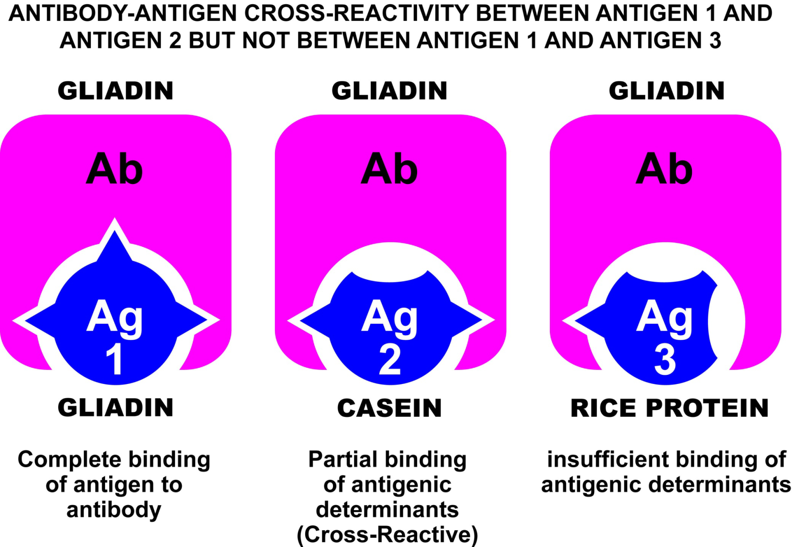
Dairy cross-reactivity

Slide 45
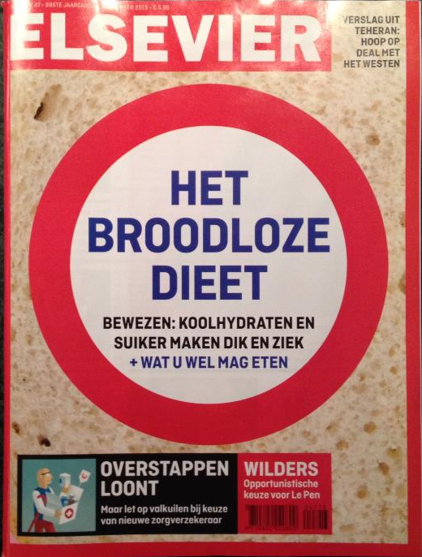
Reduce grain intake

Slide 46
Less Dairy

Slide 47
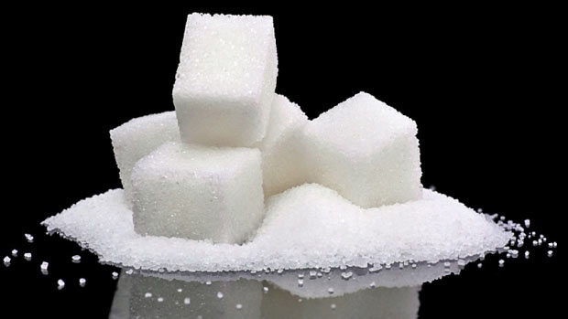
Less refined sugars

Slide 48
Foods to avoid
Avoid all refined sugars
Avoid all grains
Avoid gluten, soy, dairy

Slide 49
Foods to eat
Vegetables
Fermented foods
Sauerkraut, ginger, pickles
Meats
Fish, chicken, beef, lamb (organic)
Low glycemic fruits
Apricot, pineapple,peach, cherry, berries
Coconut
Oil, butter, milk
Herbal teas
Olives, olive oil

Slide 50
Thank you all for your attention!

Slide 51
References
Diagrams Presentation Clinical Neurochemistry

